Slide 1
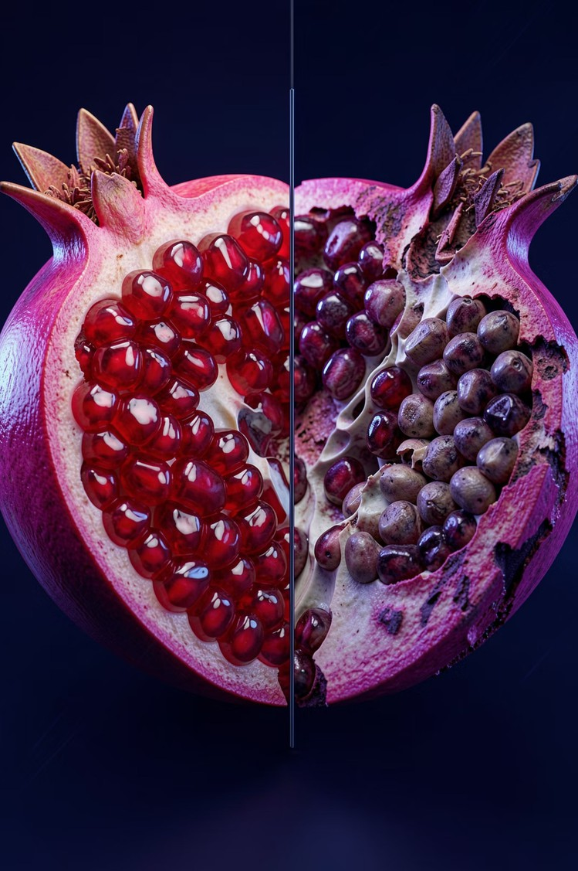
Pomegranate Fruit Disease Detection
A CNN-based software prototype for intelligent fruit disease cassification
— designed for real-world deployment on embedded hardware.
Pranav Memane ADT24SOCB0786
Harshwardhan Wable ADT24SOCB0455 Karan Nevase ADT24SOCB0530 Sahil Shaikh ADT24SOCB0965

Slide 2


Why a Software-Based Prototype?
StrategicDesign Decision
Due to hardware procurement constraints, we implemented a fully functional software-based prototype
— a recognized and academically valid methodology in embedded systems research.
"The system is architected to run on Raspberry Pi with a live camera. Currently, we demonstrate the core intelligence layer using a software prototype — the hardware integration is modular and can be added at any stage."

Slide 3
System Architecture
Input Images
CNN Model
Prediction Engine
Output Label
The architecture cleanly separates the intelligence layer from the hardware layer — making the CNN model portable, testable, and hardware-agnostic by design.

Slide 4
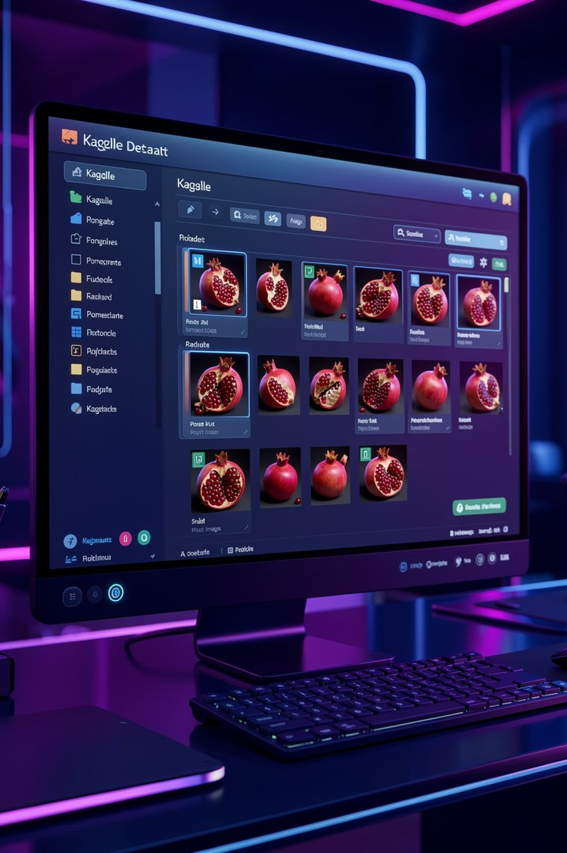
Dataset-Driven Development
We sourced labeled pomegranate fruit images from Kaggle's Pomegranate Disease Dataset — replacing live camera input with a curated, high-quality image corpus.
More Training Data
Hundreds of labeled samples vs. a handful of live captures
Better Generalization
Diverse lighting, angles, and disease stages included
Reproducible Results
Consistent benchmark for model evaluation and comparison

Slide 5
CNN Model Workflow
01
Load Dataset
Read pomegranate images from organized class folders (Healthy / Diseased)
02
Preprocess & Augment
Resize, normalize, and augment images for robust training
03
Train CNN Model
Feed data through convolutional layers to extract disease features
04
Test & Predict
Run sample images through the trained model and output classification

Slide 6
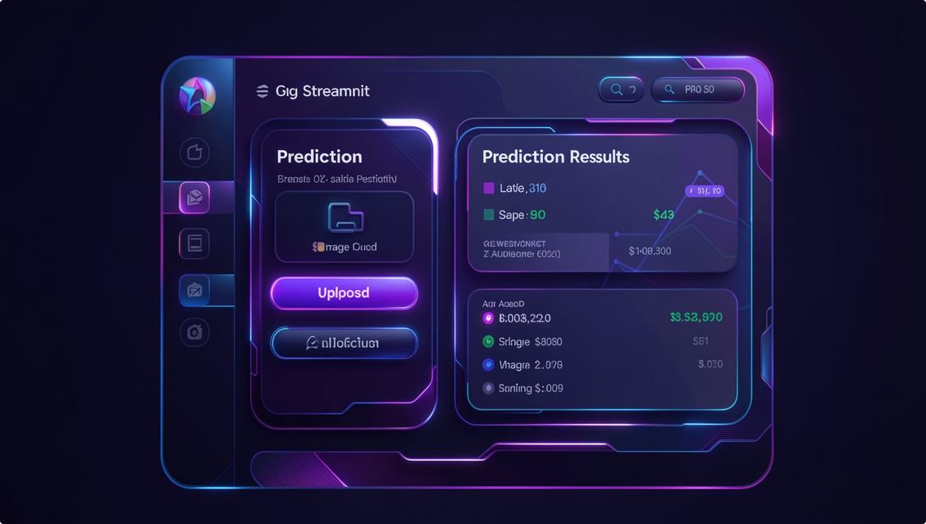

Demo Interface
Built with Python (Streamlit) A clean, interactive demo interface that makes the model accessible and evaluable without any command-line interaction.
Upload a pomegranate image Click "Predict" to run inference View result: Healthy or Diseased
with confidence score
The interface simulates exactly what a farmer-facing app would look like in field deployment.

Slide 7
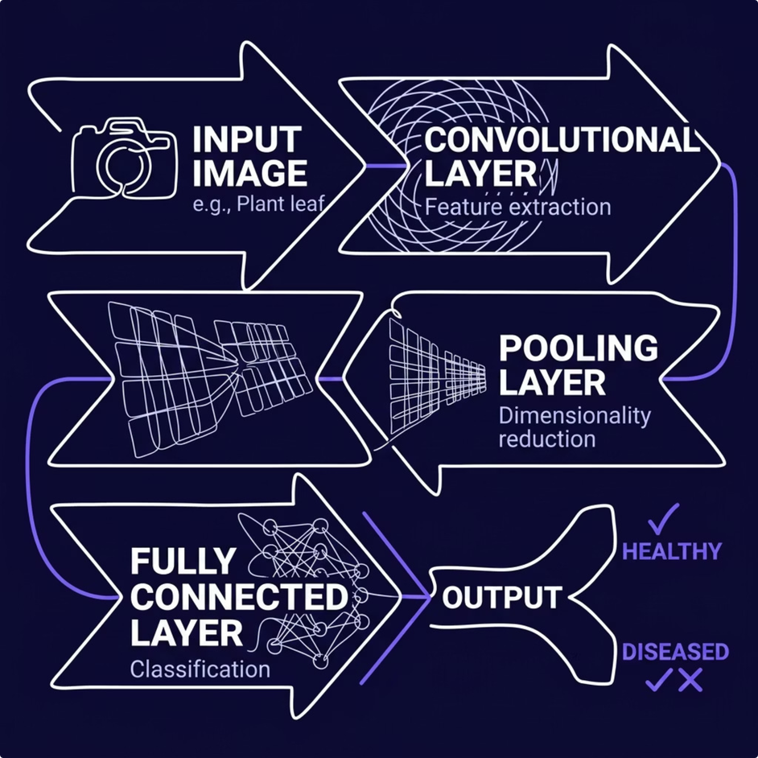
Core Intelligence: The CNN Model
What the CNN Learns
The convolutional layers automatically detect visual disease markers — discoloration, lesions, texture anomalies — without manual feature engineering.
Key design principle: The intelligence of detection is fully hardware-independent. The same trained model runs on a laptop today and Raspberry Pi tomorrow.

Slide 8
Future Scope: Hardware Deployment
Current
Software prototype on laptop with dataset input and Streamlit UI
Phase 3
Connect to cloud backend for model updates and data logging
1
2
3
4
Phase 2
Deploy trained model on Raspberry Pi with Pi Camera for real-time capture
Phase 4
Farmer-facing mobile app with push alerts and regional disease mapping
The modular architecture ensures each phase is independently deliverable — hardware integration requires no changes to the core model.

Slide 9
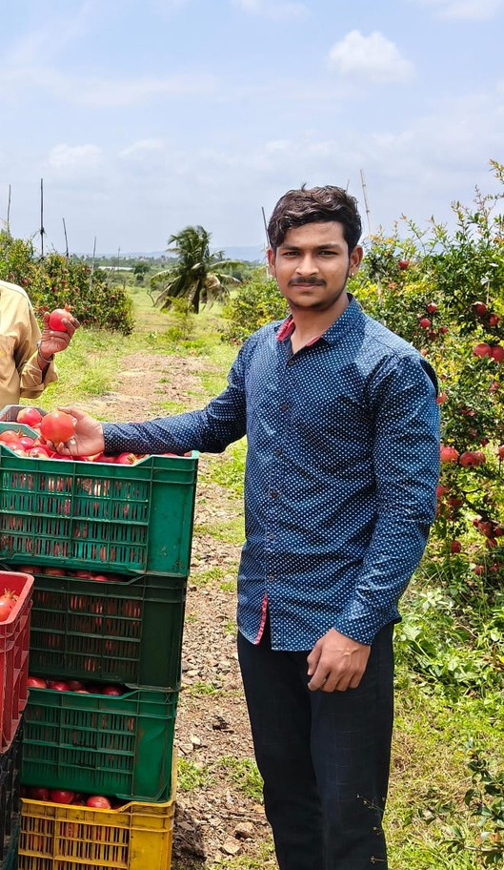

Real-World Impact
Earlydisease detection canpreventsignificantcrop losses and reduce pesticide overuse. This system brings that capability to any farmer with a smartphone camera.
Early Detection
Catch disease before it spreads across the harvest
Reduced Losses
Targeted intervention instead of blanket pesticide application
Accessible Tool
No agricultural expertise required — just point and predict

Slide 10



Key Takeaways
Software Prototype = Valid Methodology Dataset-driven training yields
more accurate, reproducible results than limited live-camera data — a deliberate and defensible design choice.
Intelligence is Modular "Our focus is on the intelligence of detection using CNN. Hardware integration is modular and can be added at any time."
Production-Ready Architecture
The pipeline — Input → CNN →
Prediction → Output — maps directly onto the Raspberry Pi deployment path with no architectural changes required.

Slide 11
Thankyou!

